Slide 1

AI Chatbots a beginner’s guide for u3a members
Host – Liz
Chair - Barry
Panel – Alan, Sandra & Isabel
u3a - Artificial Intelligence
AI for everyone library

Slide 2
Poll Questions
Have you used Copilot? Y/N
Do you think Copilot will be useful to you in the future? Y/N

Slide 3
Agenda
10.00am Poll Questions
10.05 Introduction
10.10 Breakout rooms
10.40 Feedback
10.50 Comfort break
11.00 AI programme
11.05 Breakout rooms
11.25 Poll Questions

Slide 4

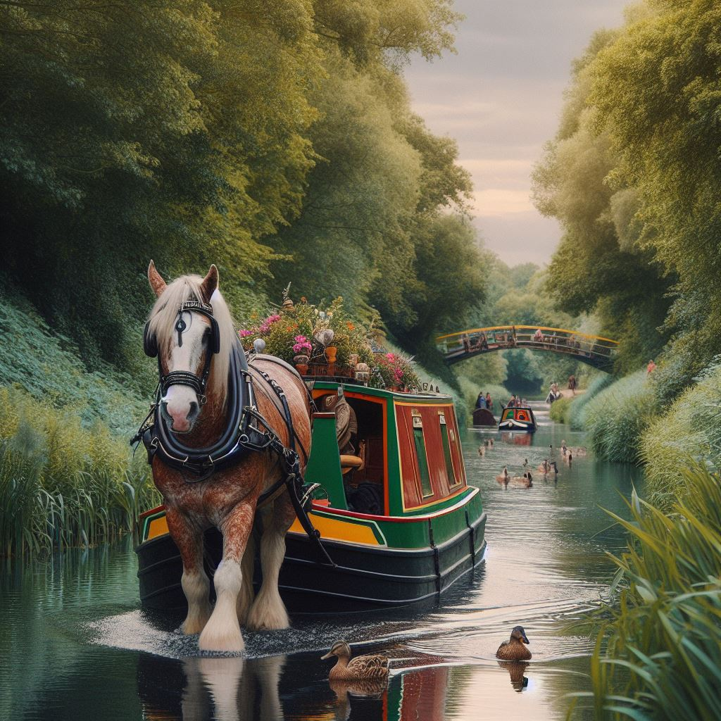
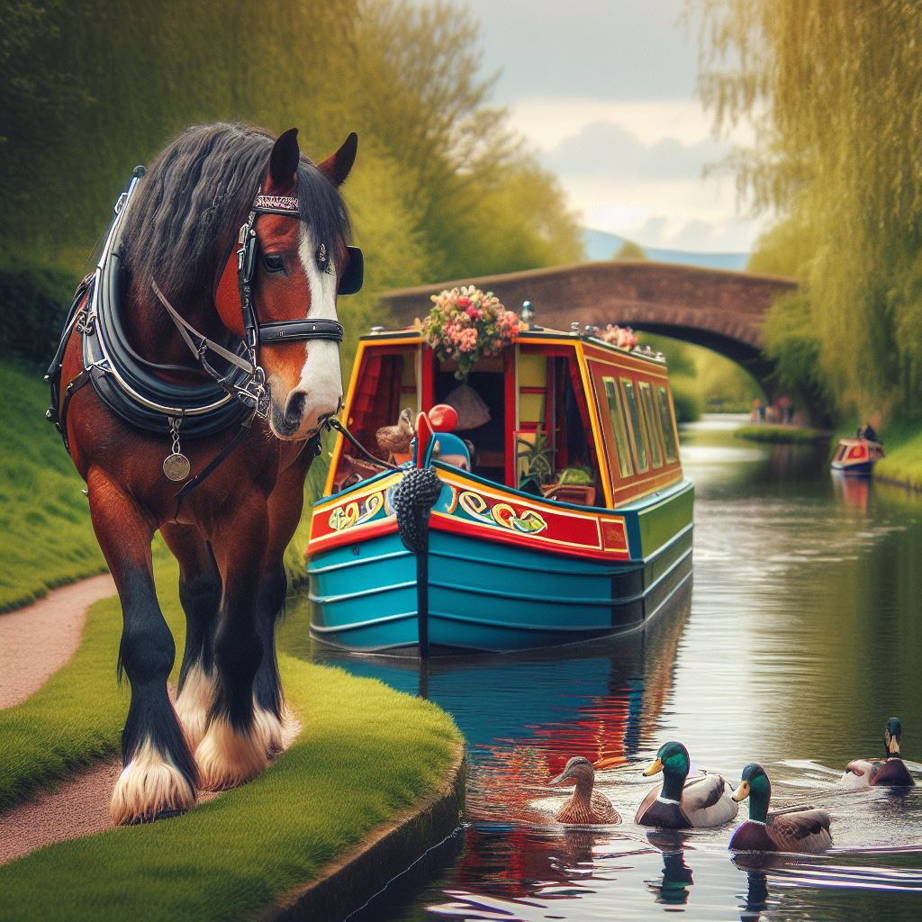
Draw a horse towing a canal boat
(Intelligence and Common Sense)

Slide 5
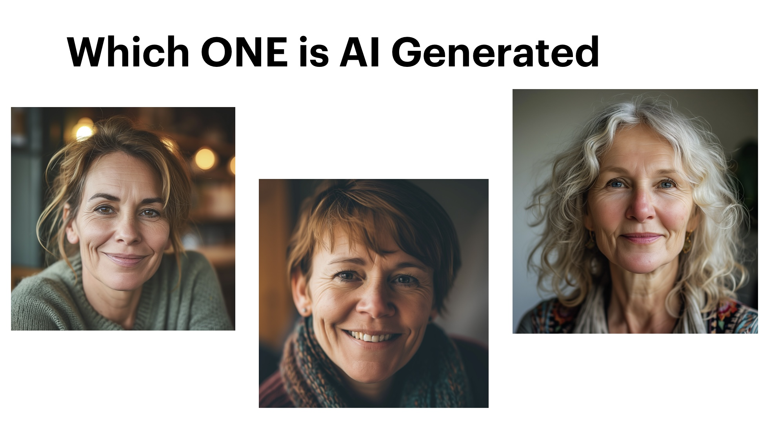
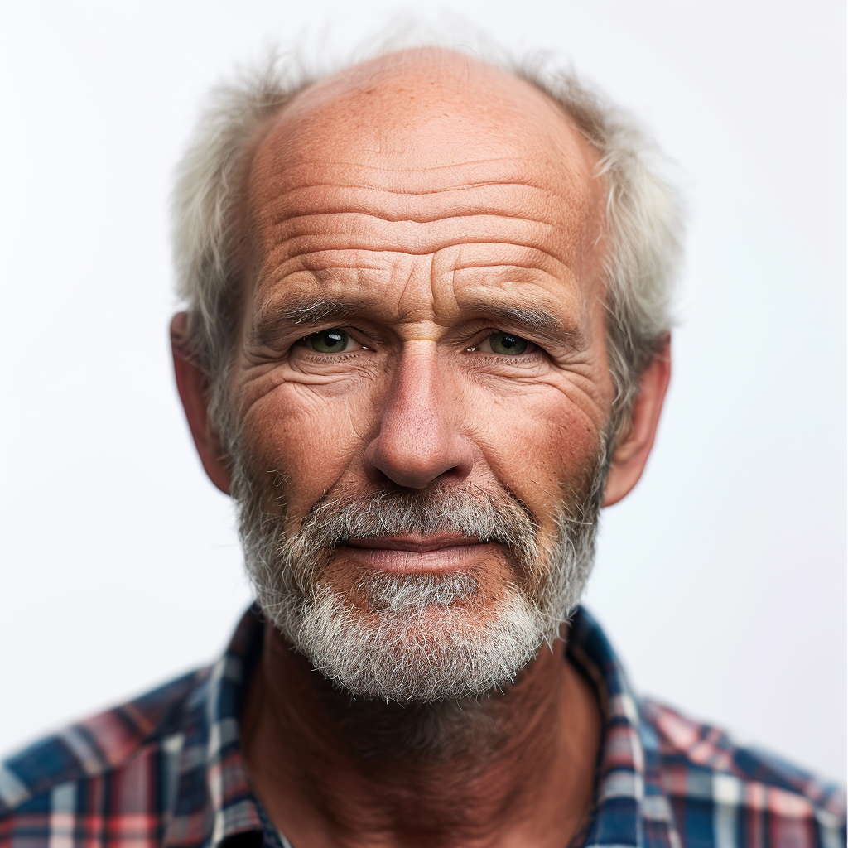

Slide 6
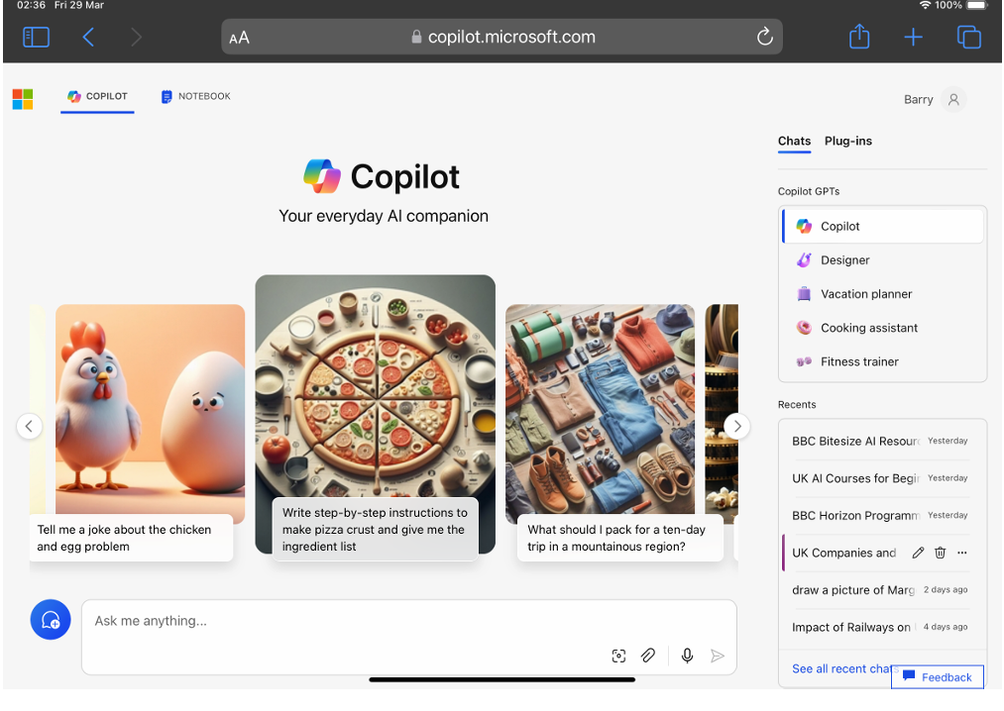
Web
or
App

Slide 7
Play
With
The
Toys

Slide 8
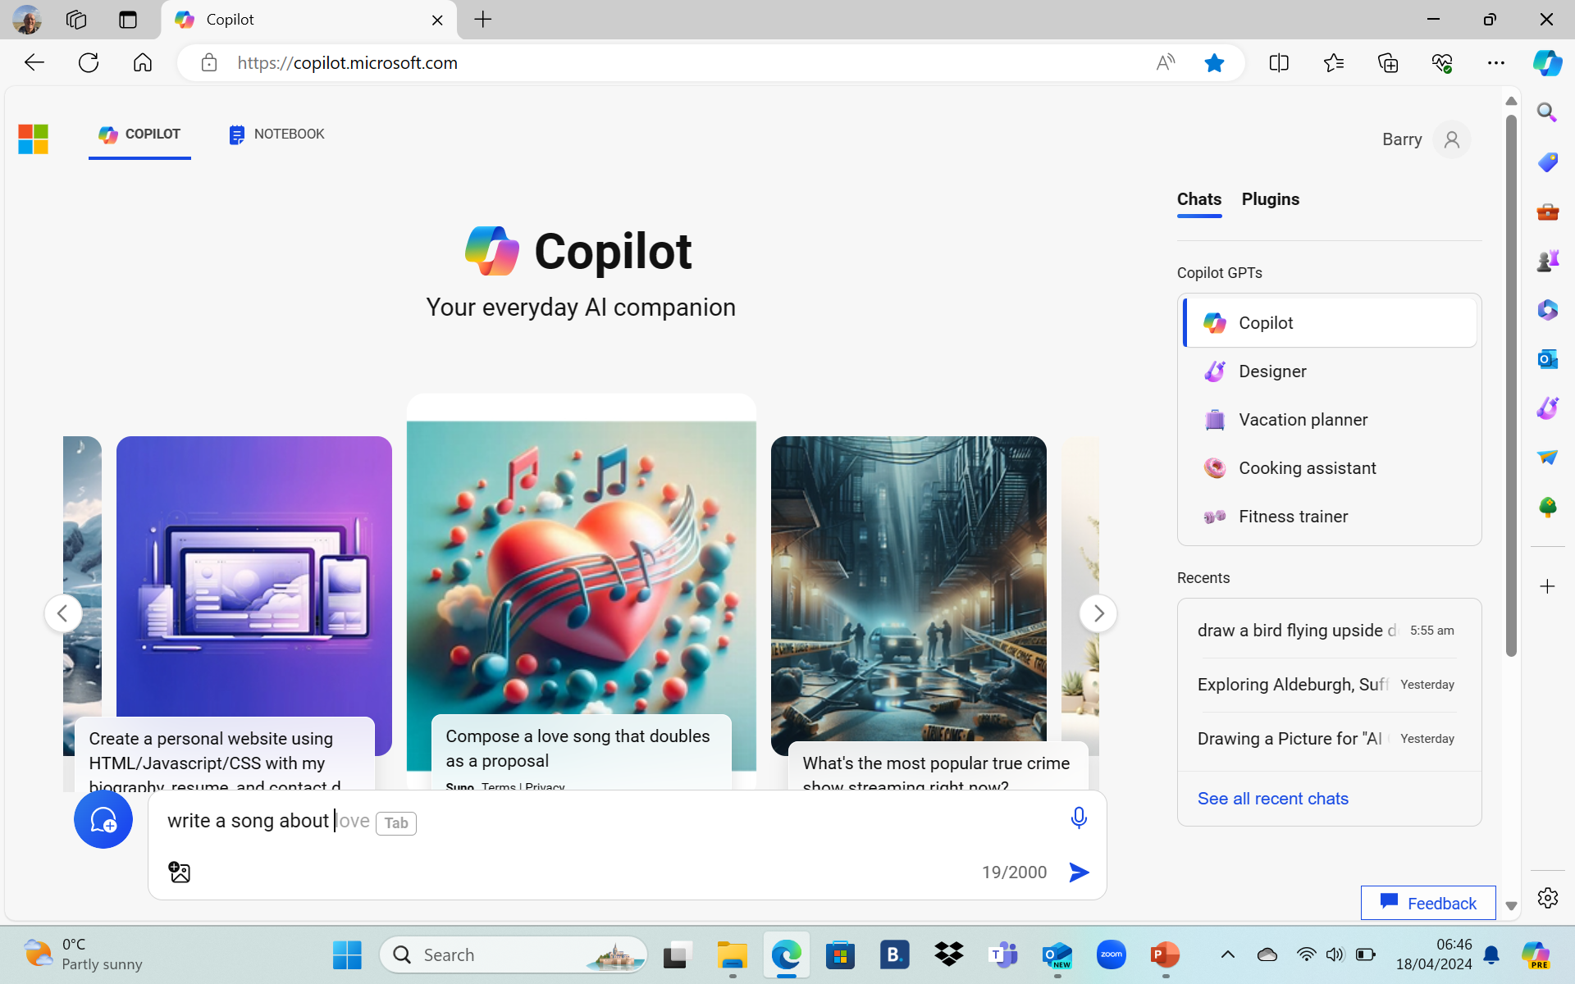
Writing Prompts
write a song about …
tell me a story about …
write a poem about …
tell me a joke …
what is a chatbot
explain simply what is a chatbot
what languages do you know
translate hello in to welsh
plan a 3 day visit to York
who is the prime minister of …
…

Slide 9
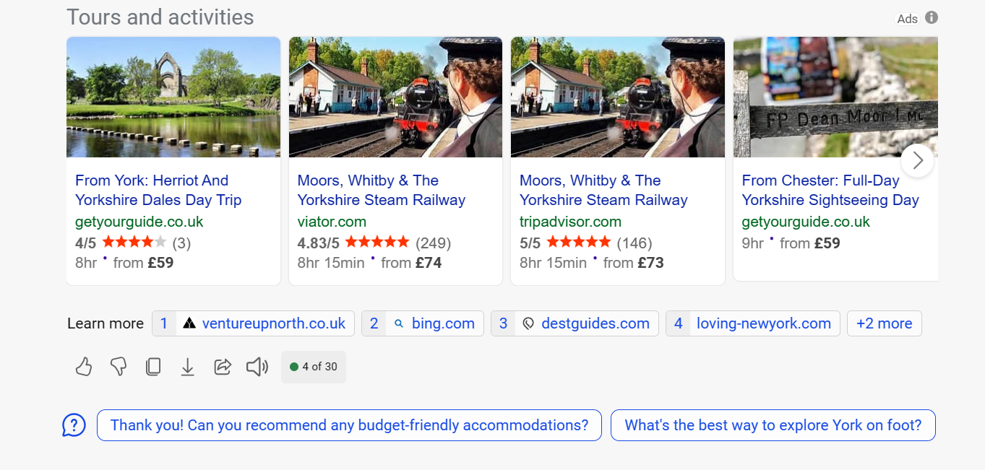
References and Suggestions
(advertising revenue)

Slide 10

Like
Copy
Share
Prompts used
Dislike
Export
Read Aloud

Slide 11
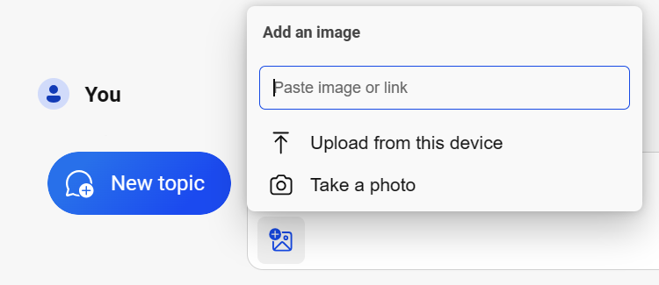
Upload and ask questions

Slide 12
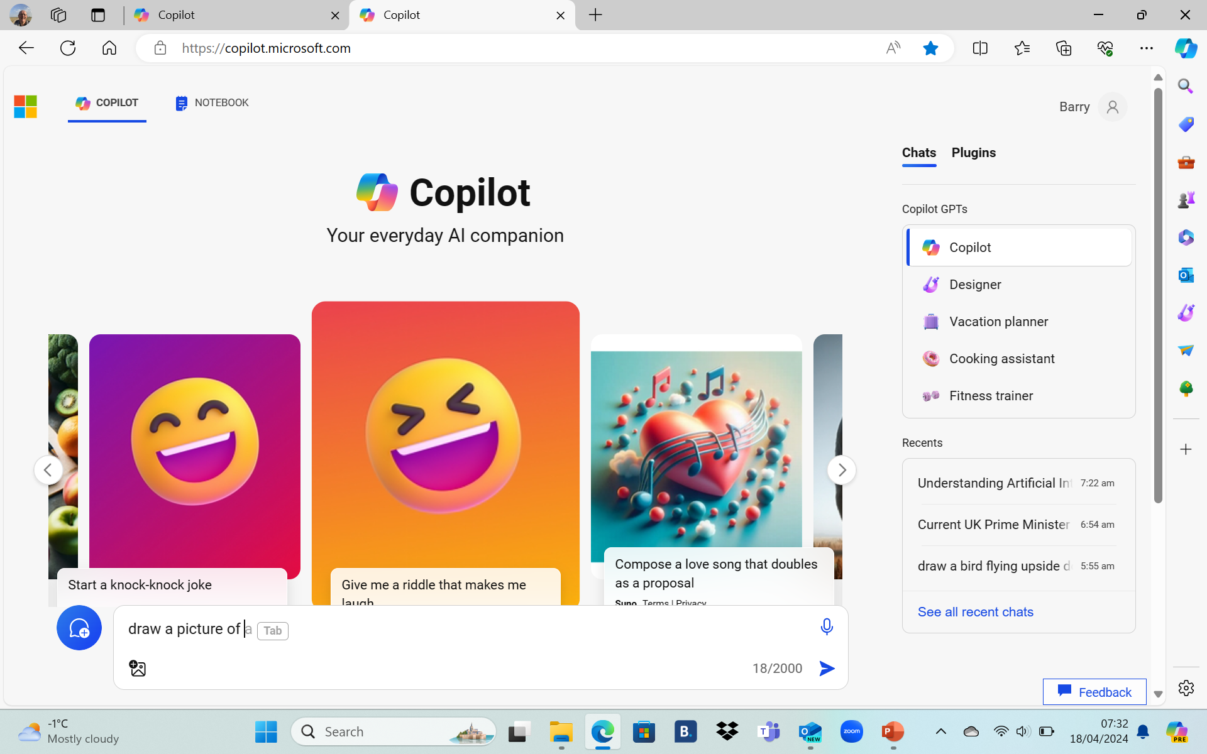
Pictures and accounts
draw a picture of a flying pig
Copilot will ask you to create a Microsoft account
or log in to your account
draw a picture of a flying pig in the style of picasso
draw a field of flying pigs
draw me coming home to my family
…

Slide 13
Breakout rooms
Try writing prompts
Show and tell

Slide 14
Feedback

Slide 15
Comfort Break

Slide 16
AI for everyone library
Online Learning Events
AI news, May, Wednesday 22nd May 3.30pm
Our AI-Enhanced future,
Promises and Preparations
AI Chatbots, asking the right questions Wednesday 5th June, 10am
AI news June, Omnibus edition, Friday 21st June 9.30-12.3-
People-Centred AI, Health & Social care,
Equality, Diversity & Inclusion (EDI), training in your u3a

Slide 17
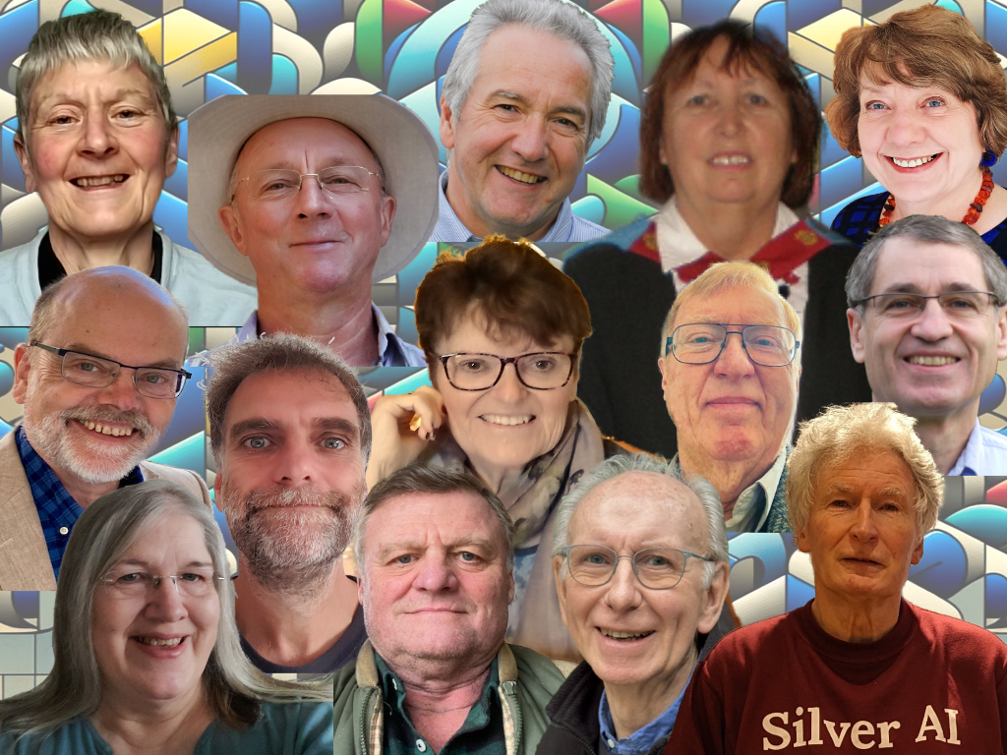
Joining the AI team
to help other members learn about AI Chatbots
Email your AI Subject adviser
u3a.ai.adviser@icloud.com

Slide 18
Breakout rooms
Try writing prompts
Show and tell

Slide 19
Poll Questions
Have you used Copilot? Y/N
Do you think Copilot will be useful to you in the future? Y/N

Slide 20
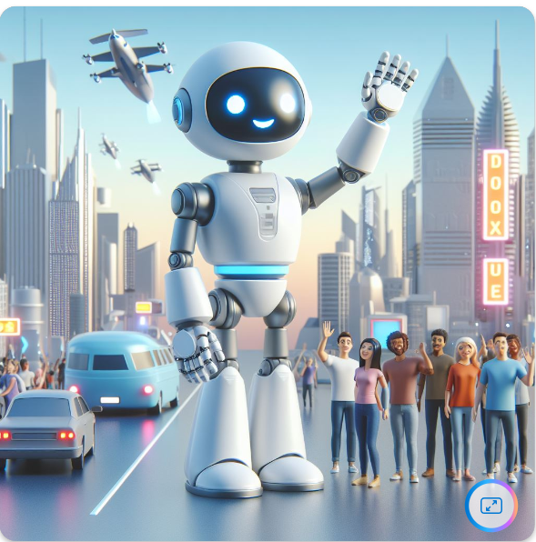
Goodbye

