Slide 1
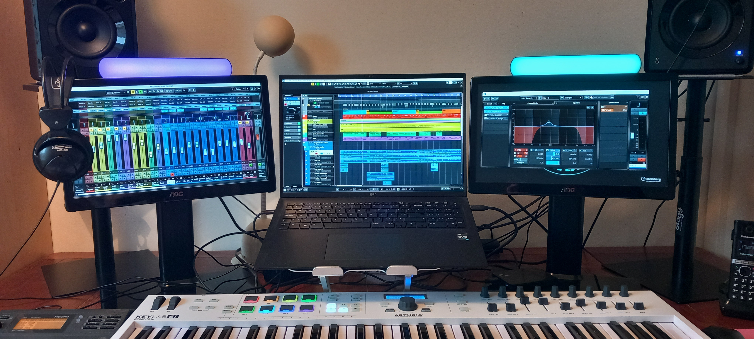
A Digital audio workstation

Slide 2
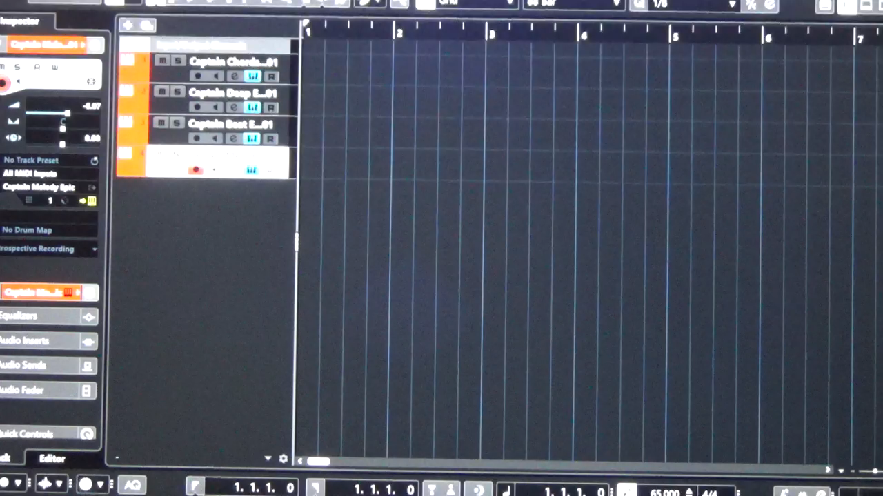
AI song composition

Slide 3
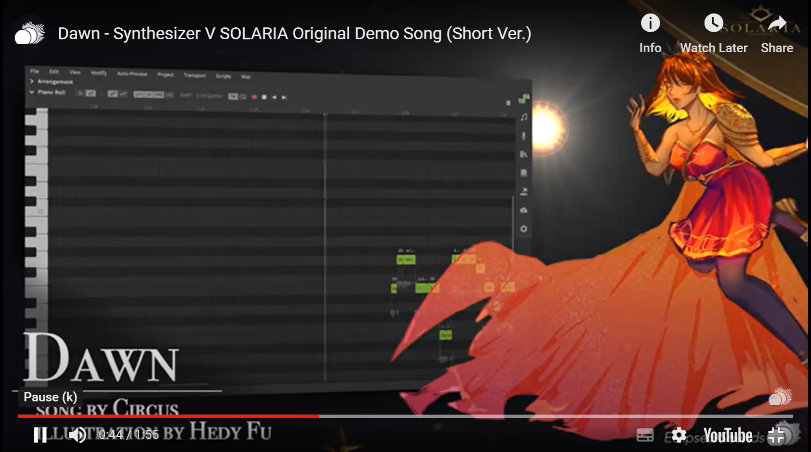
Solaria (it/it) – AI vocals

Slide 4
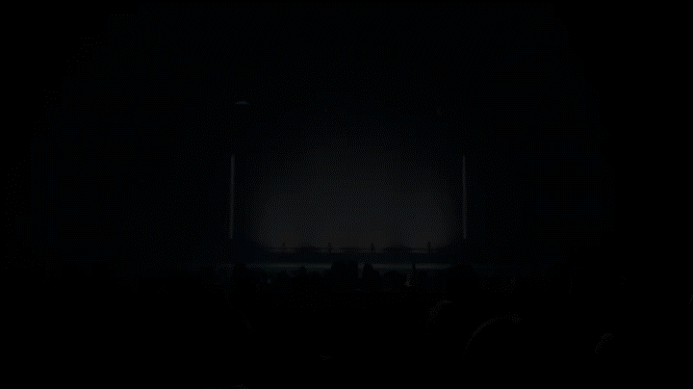
Abba voyage

Slide 5
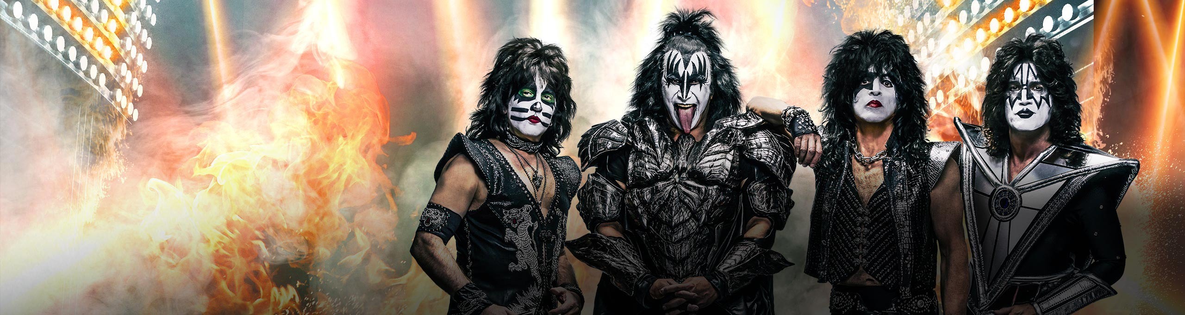
kiss

Slide 6
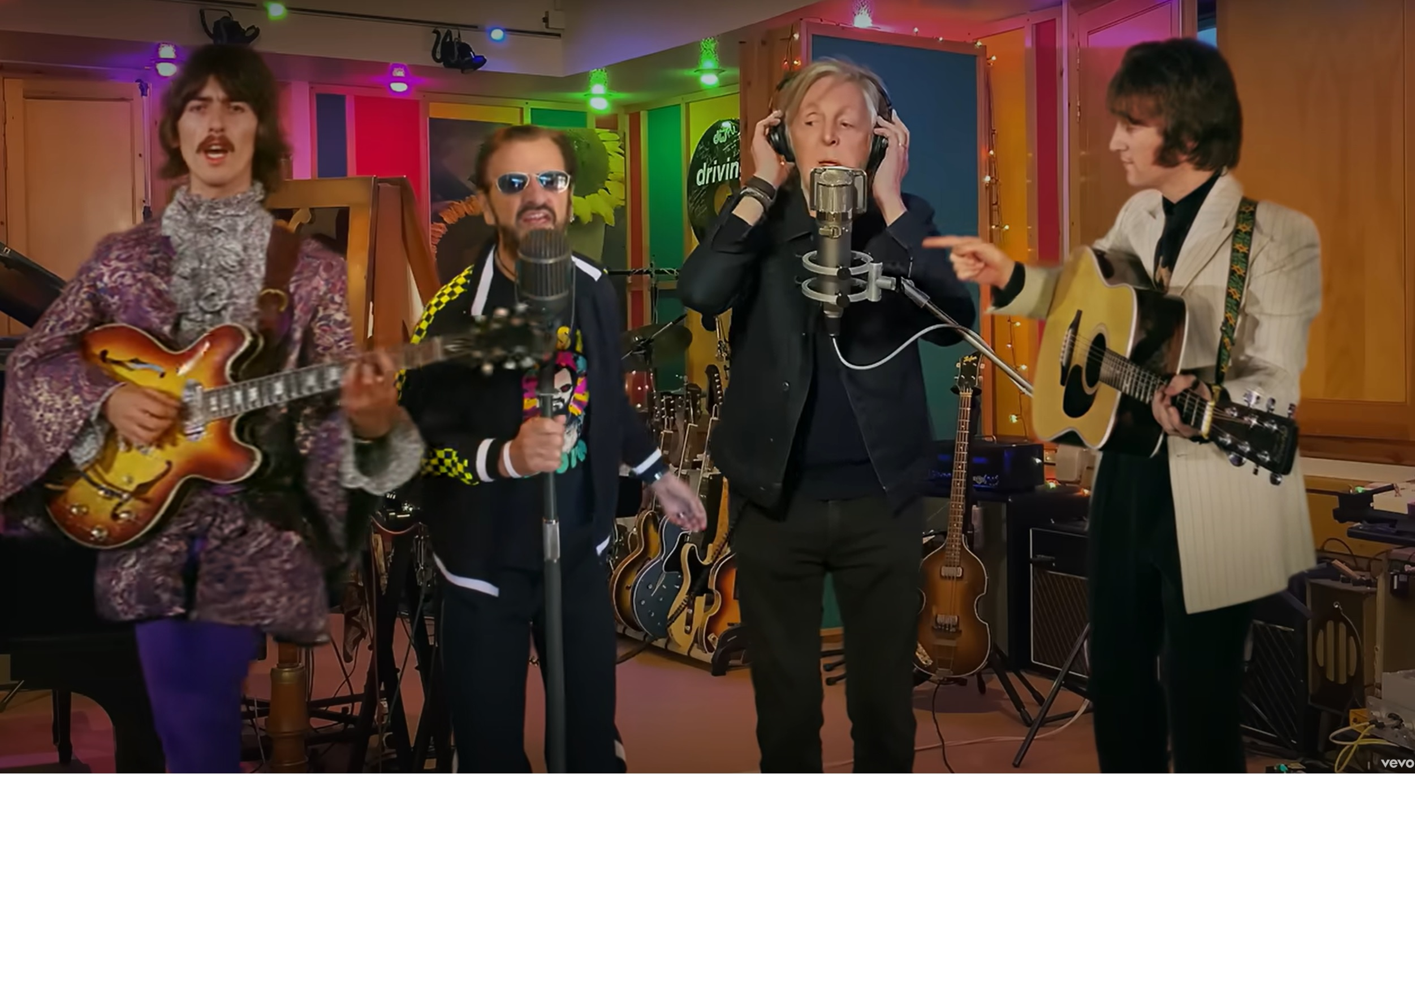
Beatles – now and then
Notes:
Bing Videos

Slide 7
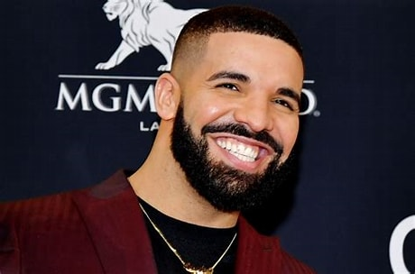
drake

Slide 8

anna Indiana – ai singer / songwriter

Slide 9
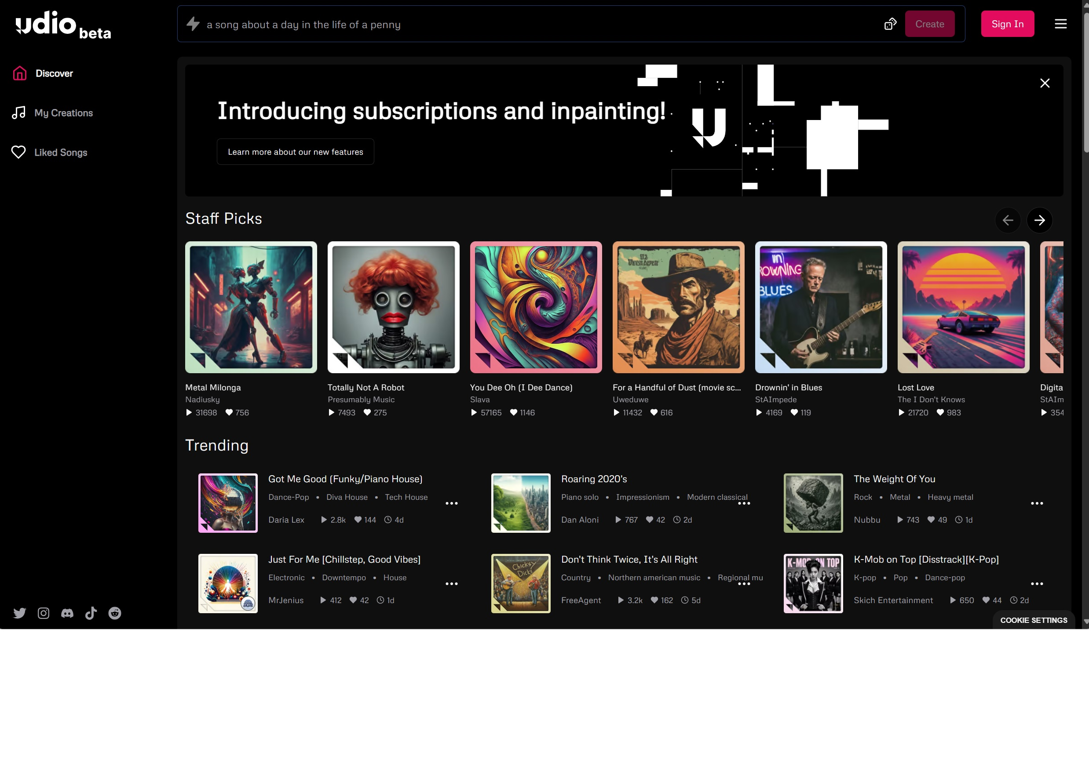
Udio – ai music creator
Notes:
Udio | AI Music Generator - Official Website
Suno

Slide 10
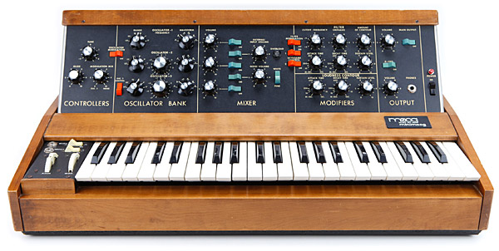
1970s - synthesizer

Slide 11
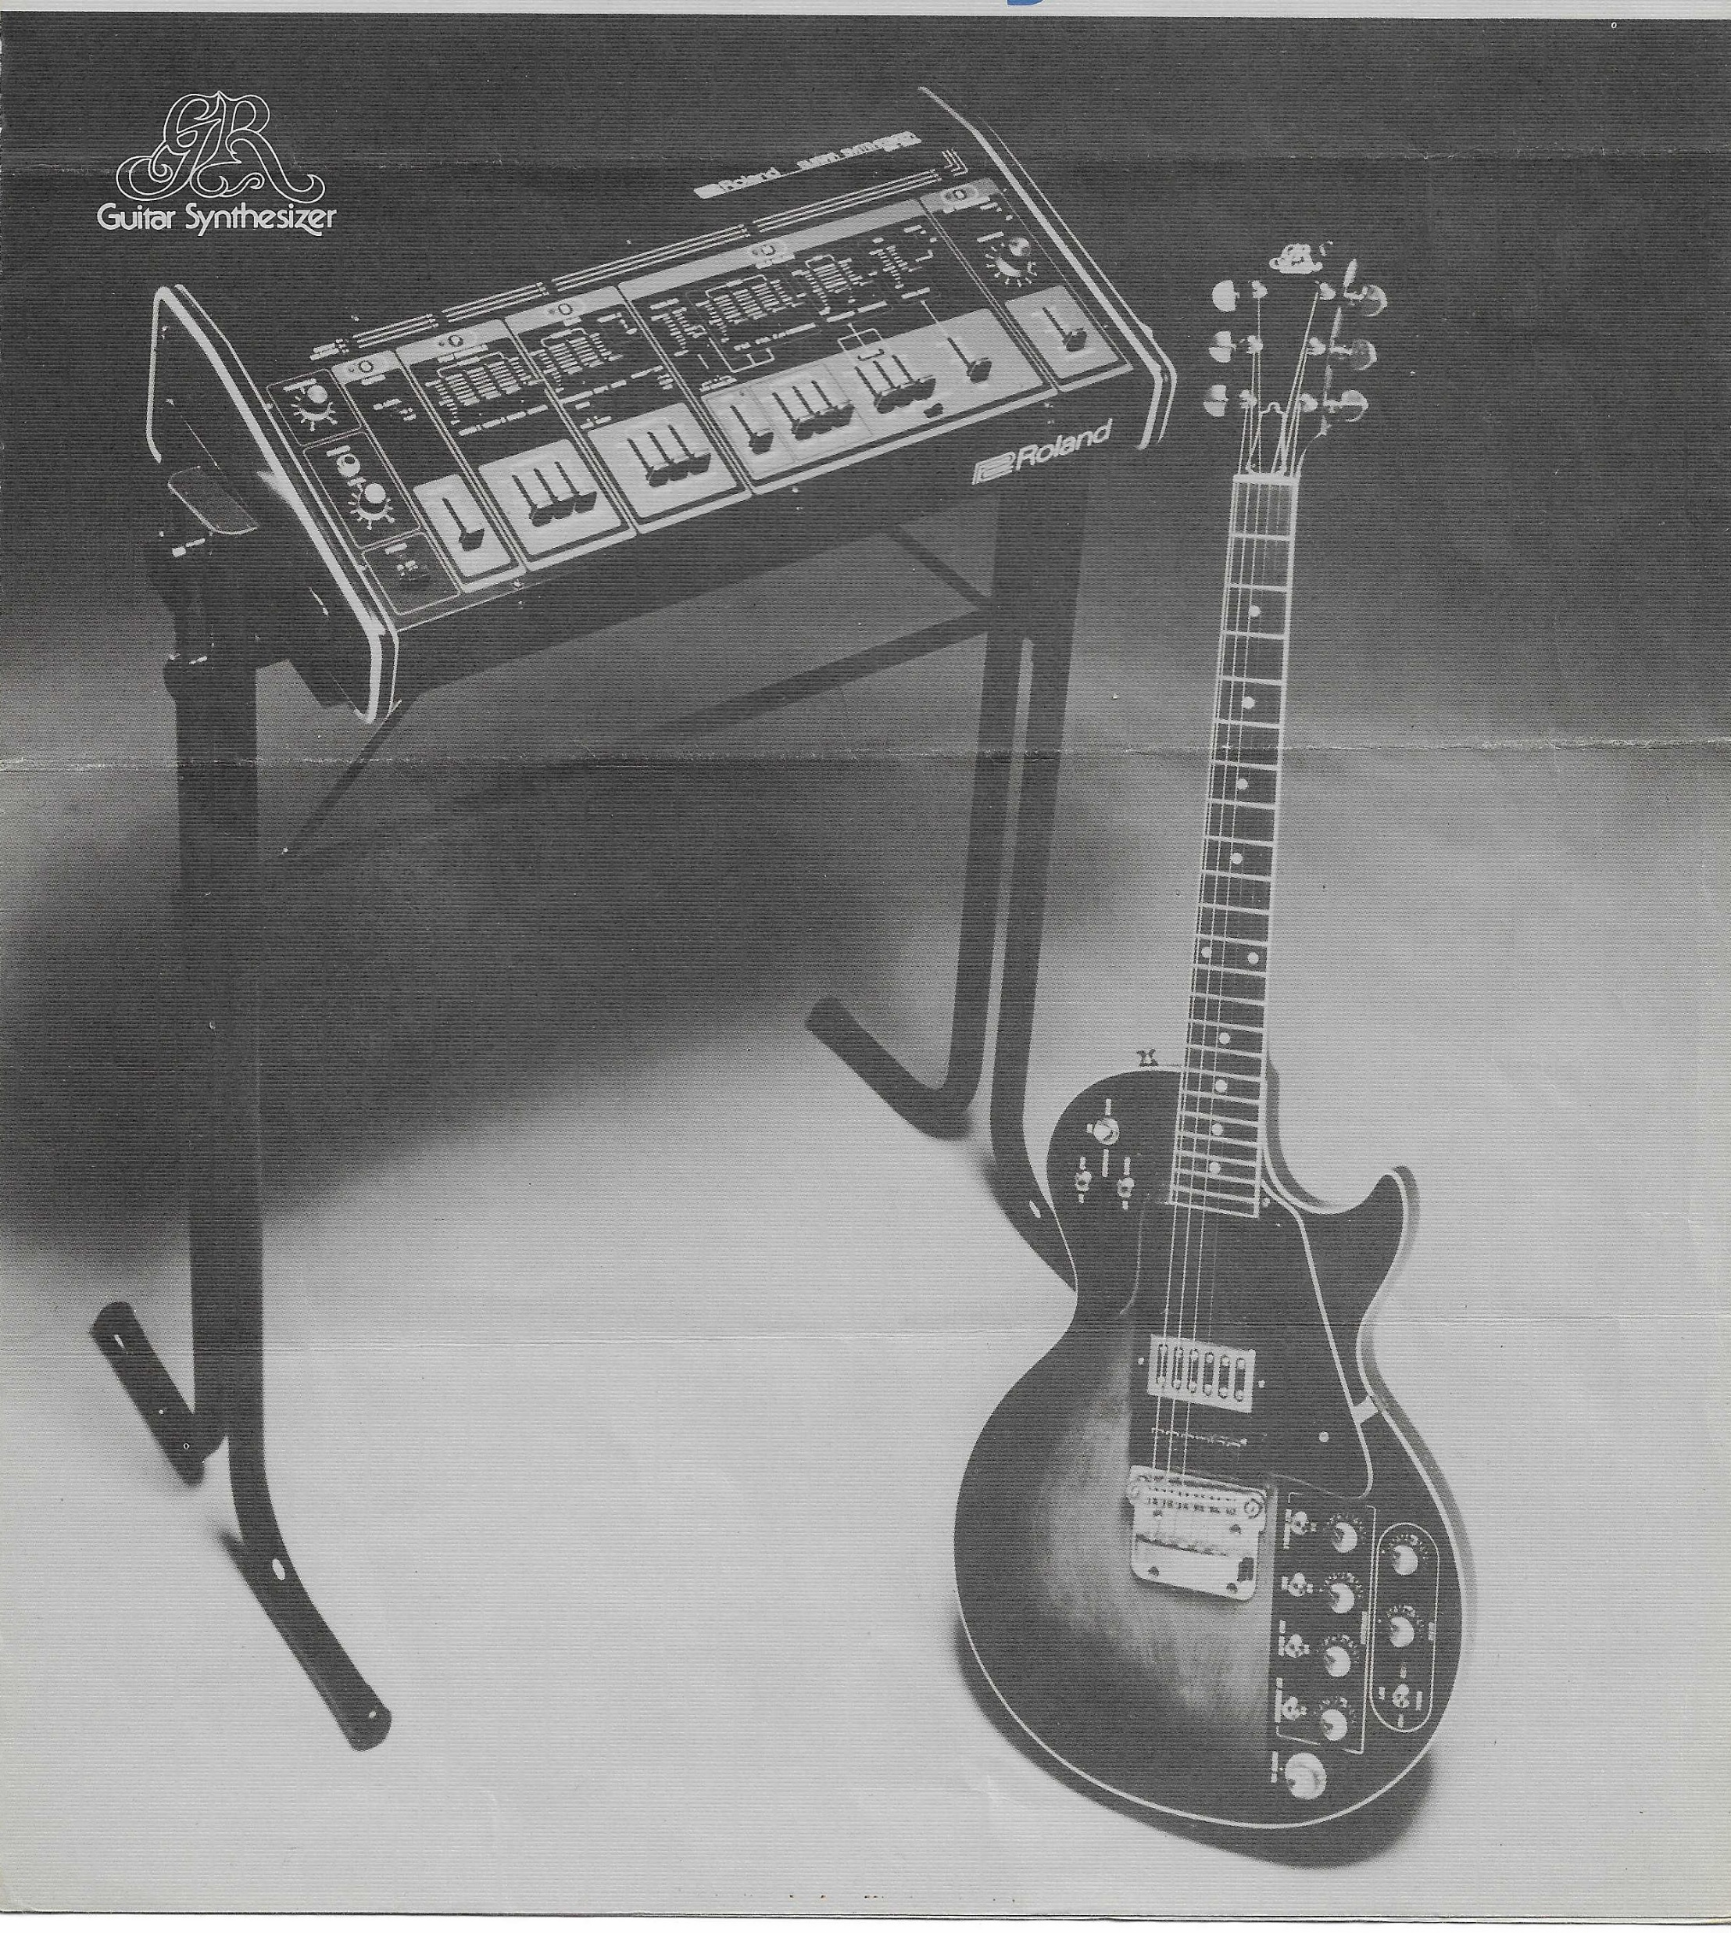
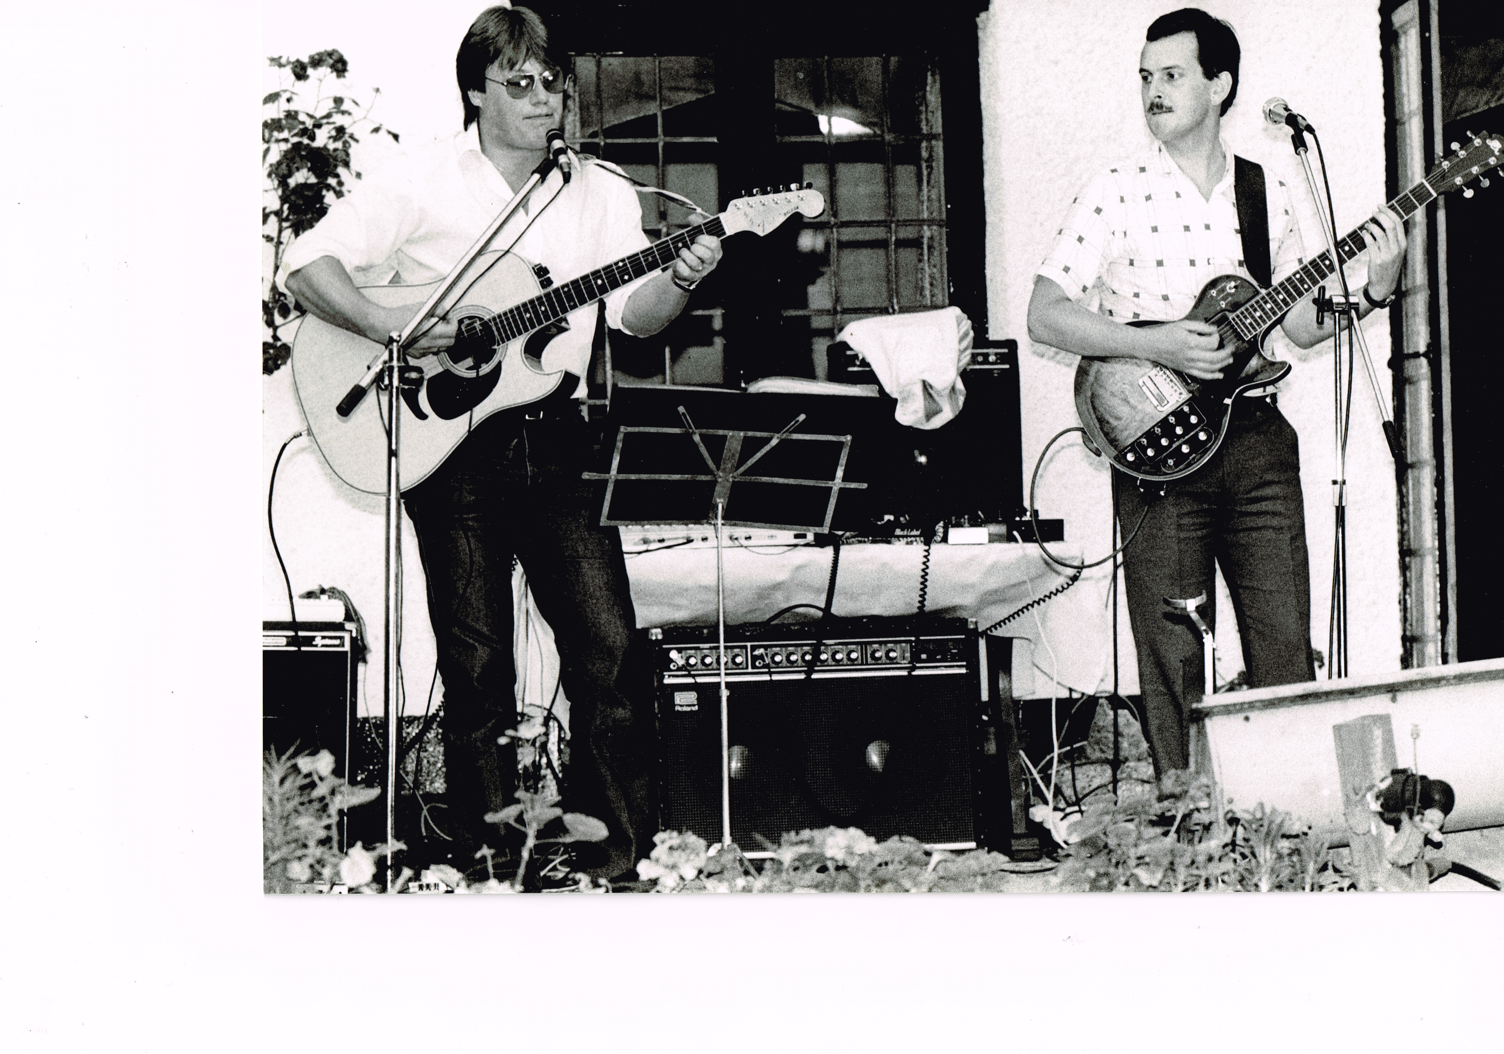
World’s first guitar synthesizer

Slide 12
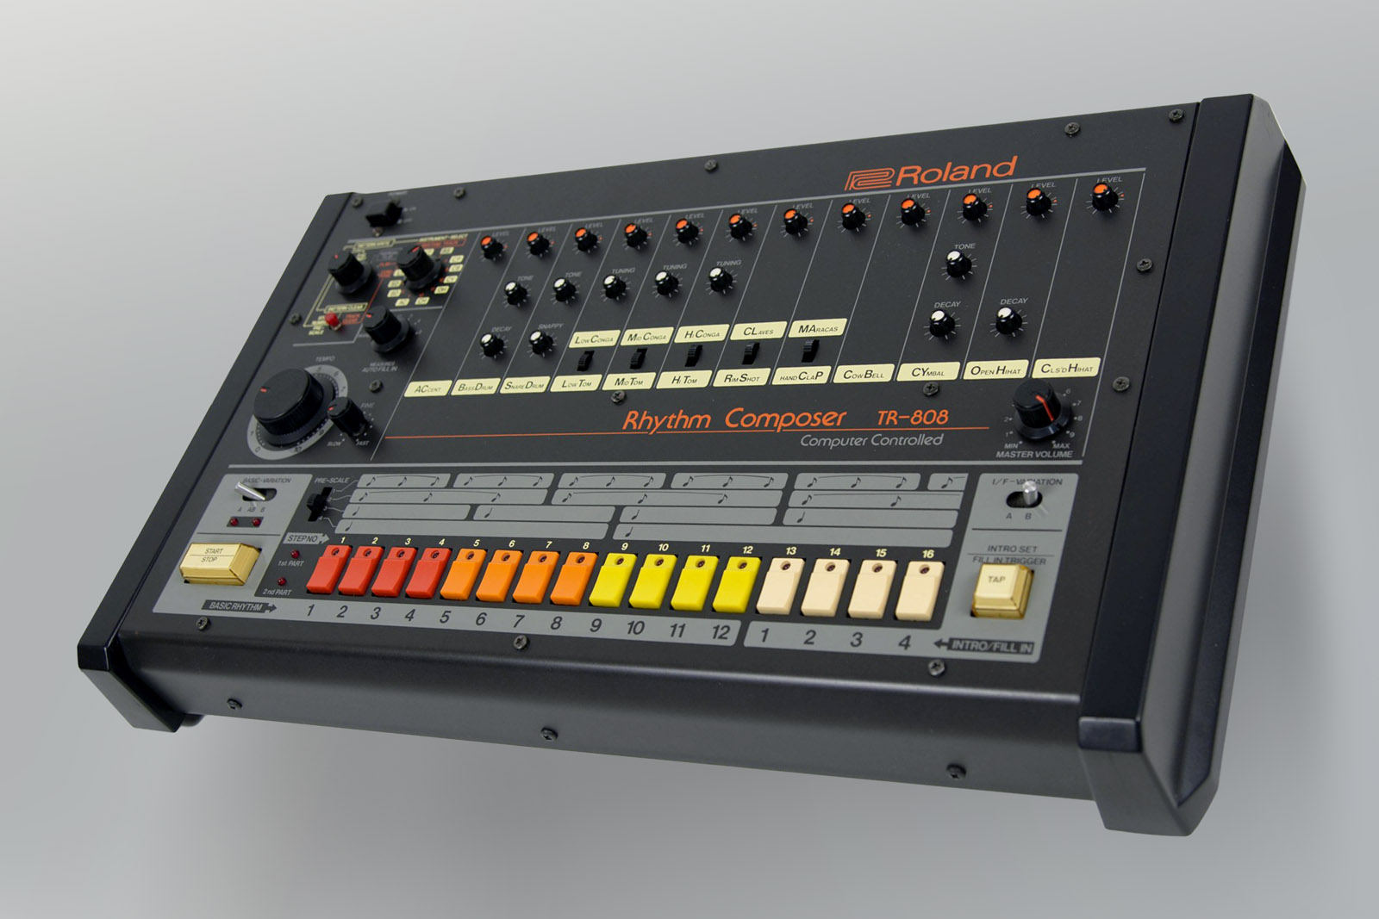
1980s - Drum machine

Slide 13
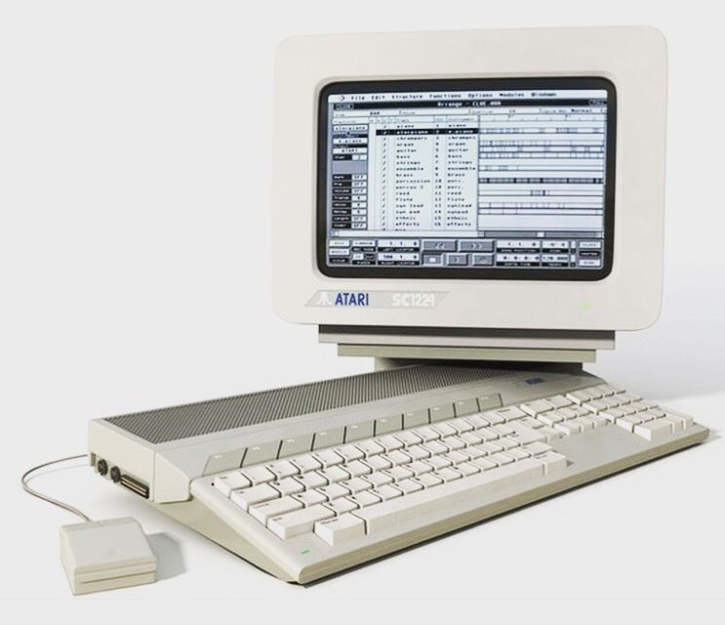
1990s - Music sequencer

Slide 14
The impact
1. Music Creation
2. Content Curation and Recommendation
3. Production and Mixing
4. Copyright and Content Identification
5. Live Performances and Concerts
6. Music Analysis and Insights
7. Collaboration and Remixing
8. Enhanced Fan Engagement
Notes:
The impact of AI on the music industry is multifaceted and likely to be significant. Here are several ways AI is already influencing and is expected to continue impacting the music industry:
1. Music Creation: AI algorithms can generate music autonomously or assist composers and producers in creating new compositions. This includes AI-generated music tailored to specific moods, genres, or even personalized to individual preferences. Companies like Amper Music and Jukedeck are already offering AI-generated music for various purposes.
2. Content Curation and Recommendation: Streaming platforms use AI algorithms to analyze user preferences and behavior to curate personalized playlists and recommendations. This not only enhances user experience but also helps artists reach new audiences.
3. Production and Mixing: AI tools can assist in the production and mixing process, automating certain tasks like mastering, equalization, and noise reduction. This can streamline the production process and make it more accessible to independent artists.
4. Copyright and Content Identification: AI-powered content recognition systems help identify and manage copyright issues by detecting unauthorized use of music across various platforms, thus protecting the rights of artists and content creators.
5. Live Performances and Concerts: AI technologies like holograms and virtual reality can create immersive live performances, allowing artists to reach audiences in new ways and potentially reducing the logistical challenges of touring.
6. Music Analysis and Insights: AI can analyze vast amounts of music data to provide insights into trends, audience preferences, and market dynamics. This information can be valuable for artists, labels, and marketers in making strategic decisions.
7. Collaboration and Remixing: AI tools enable collaborative music creation across geographical boundaries, allowing artists to work together remotely. Additionally, AI can assist in remixing existing tracks or creating new versions of songs, offering fresh interpretations and expanding creative possibilities.
8. Enhanced Fan Engagement: AI-powered chatbots and virtual assistants can engage with fans, providing personalized experiences such as answering questions, delivering exclusive content, or even simulating interactions with artists.

Slide 15
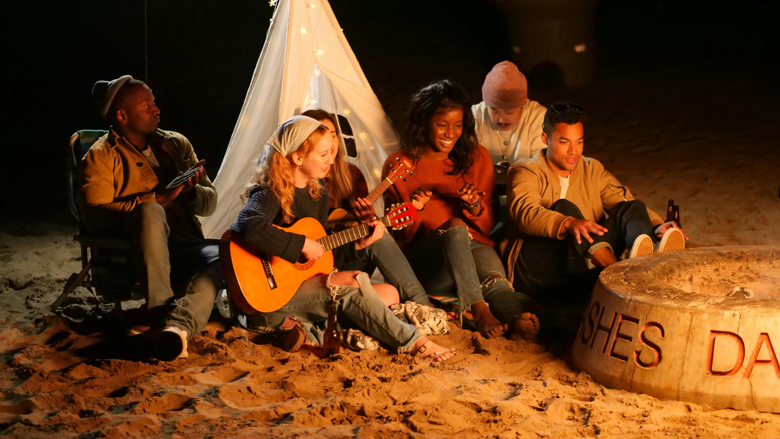

Slide 16
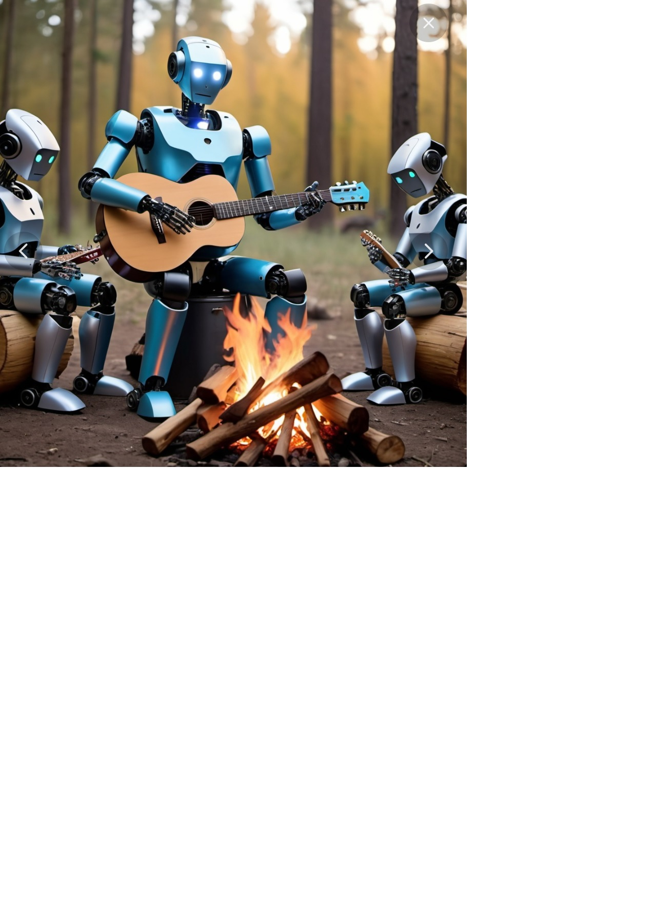
Oh dear!

Slide 17

ARTIFICIAL INTELLIGENCE IN THE MUSIC INDUSTRY
The Present
The Future
The Past

