Slide 1
How AI can help disabled people
Alex Barker-Disability Consultant
2024

Slide 2
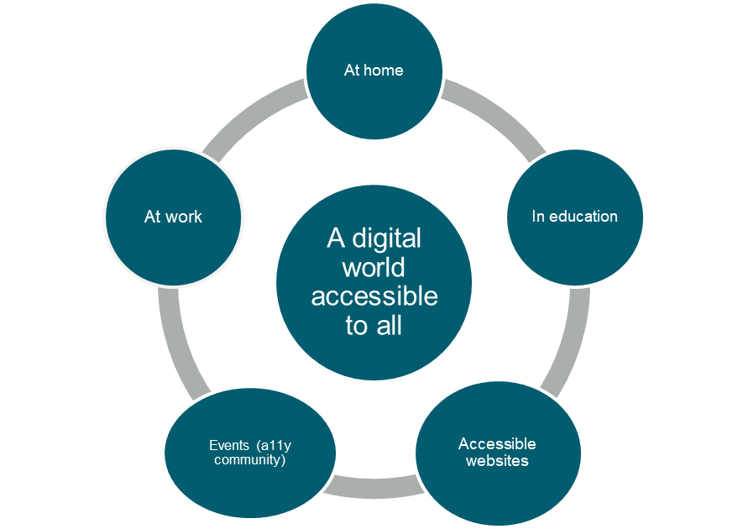
Who are we?
AbilityNet supports people of any age, living with any disability or impairment to use technology to achieve their goals at home, at work and in education.
We do this by providing specialist advice services, free information resources and by helping to build a more accessible digital world

Slide 3
Free Resources
500 + volunteers who can solve IT issues either remotely or F2F.
Factsheets, webinars and “how to guides” all on our website
ConnectingU scheme
News and Blogs

Slide 4
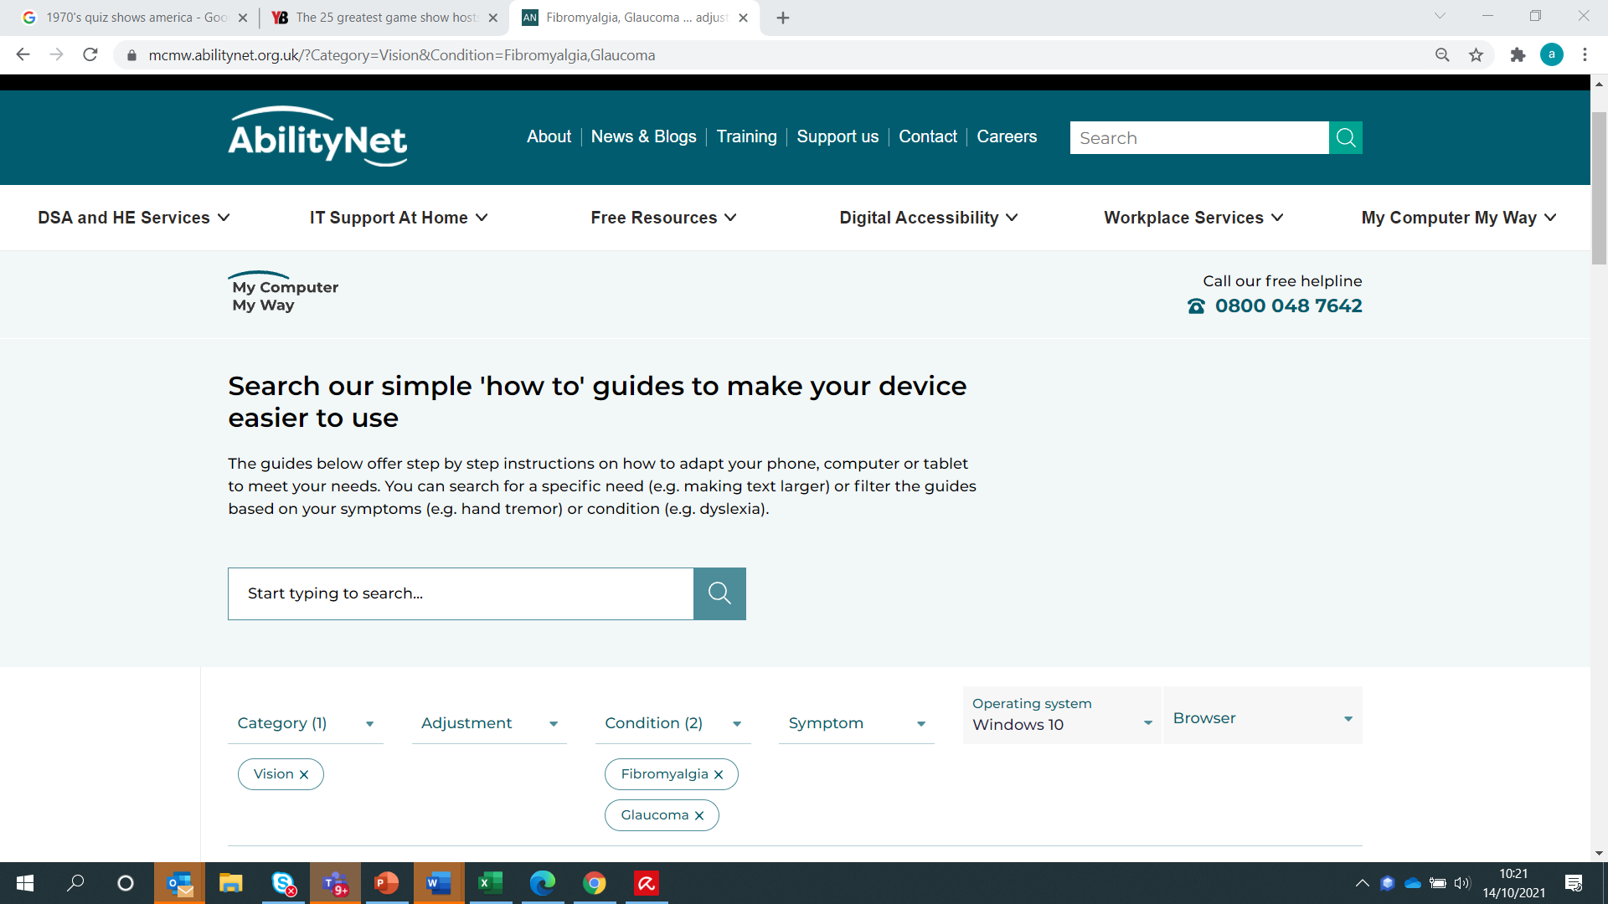
My Computer My Way
Link: https://mcmw.abilitynet.org.uk/

Slide 5
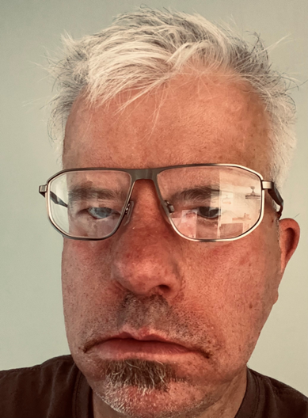
About me
I have worked for AbilityNet for 20 years in two periods
I have a rare condition called Moebius Syndrome
I only have two fingers on each hand
I have a paralysed face. I cannot show any emotions
Without tech I wouldn’t have a job, wouldn’t have gone to college/university and studied abroad (USA, Sweden).
I met my wife online and she has the same disability as me. We met on Facebook. She lived in North Carolina, USA, and moved to Coventry in 2018. We were an internet sensation for 15 minutes.
I know what it is like to struggle to get my work down. I can relate to clients

Slide 6
How can AI help disabled people?
Alexa and Siri, Amazon and Apple’s digital voice assistants, are much more than a convenient tool—they are very real applications of artificial intelligence that is increasingly integral to our daily life. They both rely on natural language generation and processing and machine learning, forms of artificial intelligence, in order to effectively operate and perform better over time.
Are Alexa And Siri Considered AI? | Bernard Marr

Slide 7
Digital voice assistants
Can help people manage their day to day lives (diary management, pill reminders, motivational quotes etc)
They can also control products around your house and convert it into a “smart house”,
Notes:
Cap opener
Pen Grip
Muggi
Key turner

Slide 8
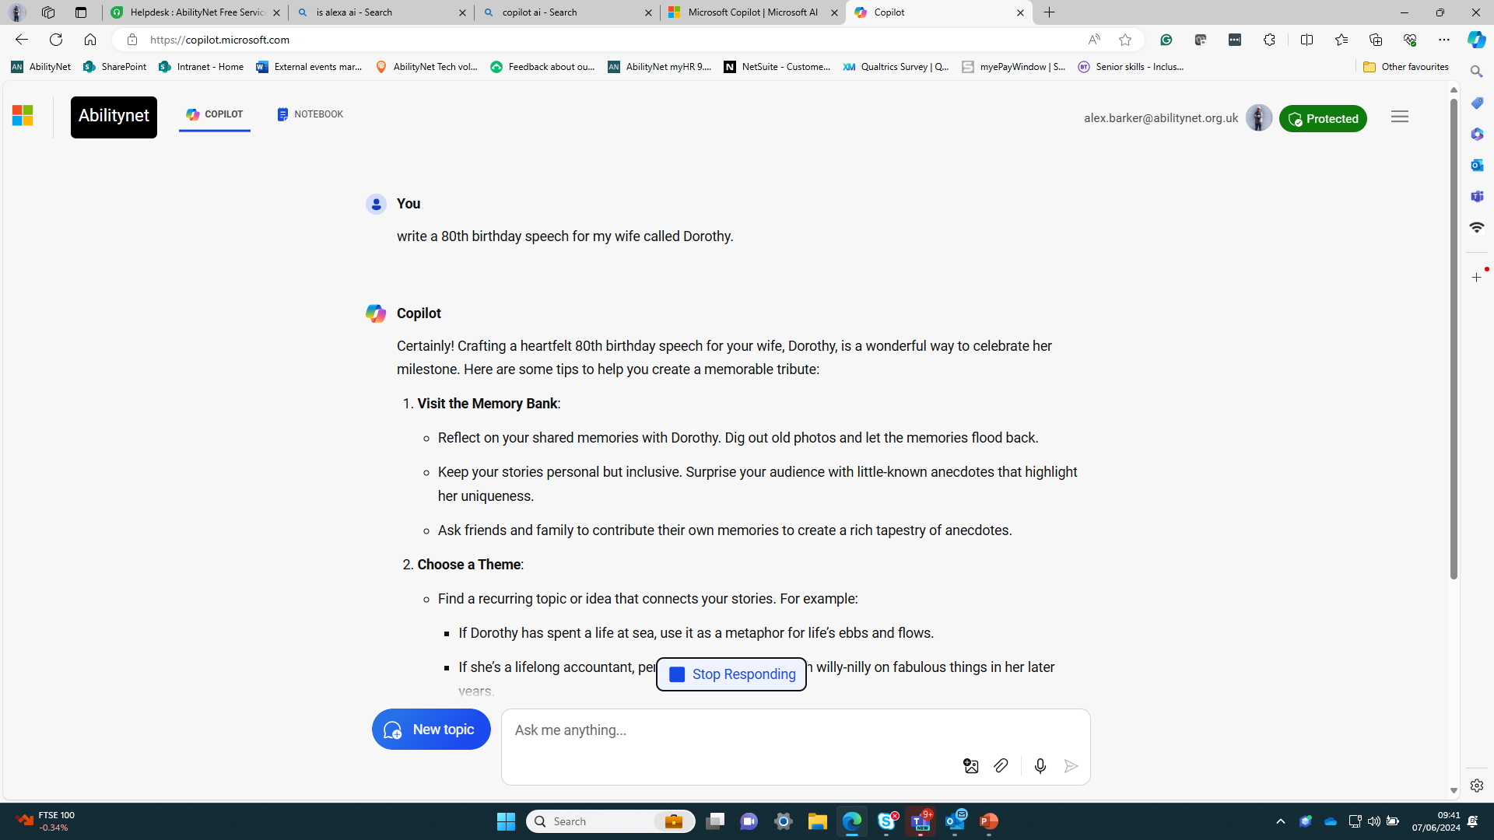
AI can also help you come up with ideas.
Co-pilot

Slide 9
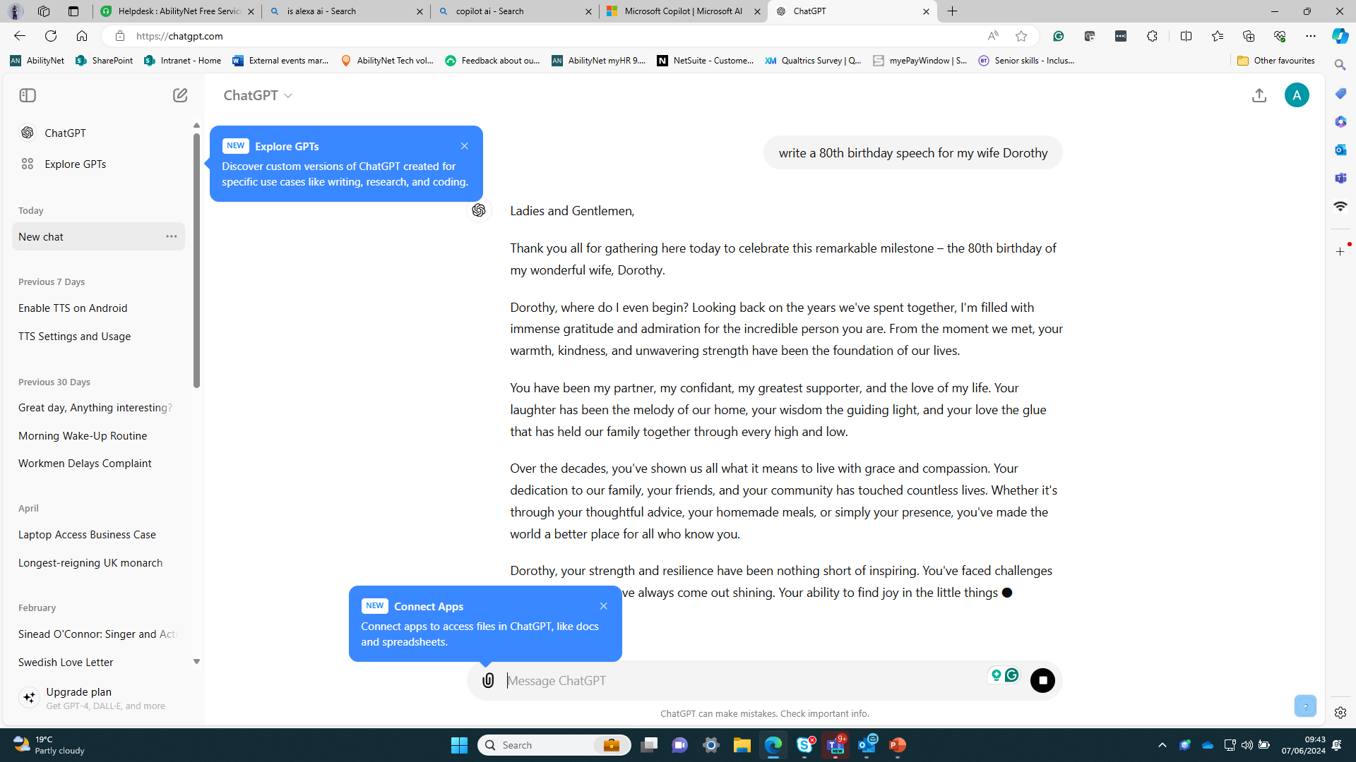
Can help you come up with speeches etc
Chat GPT

Slide 10
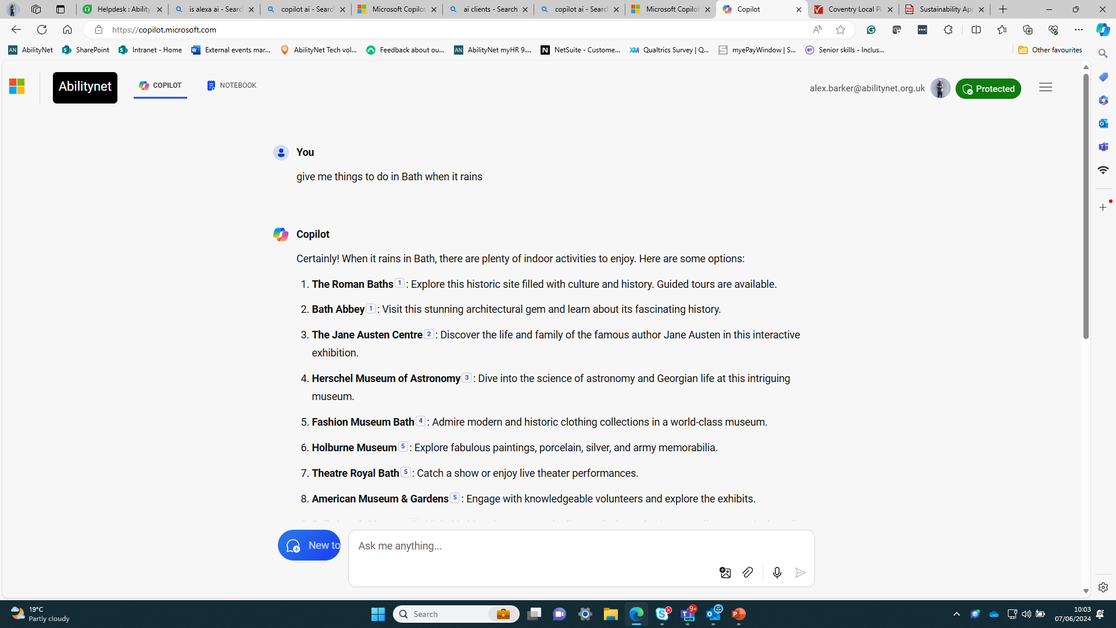
Can help you come up with an itinerary
Co Pilot

Slide 11
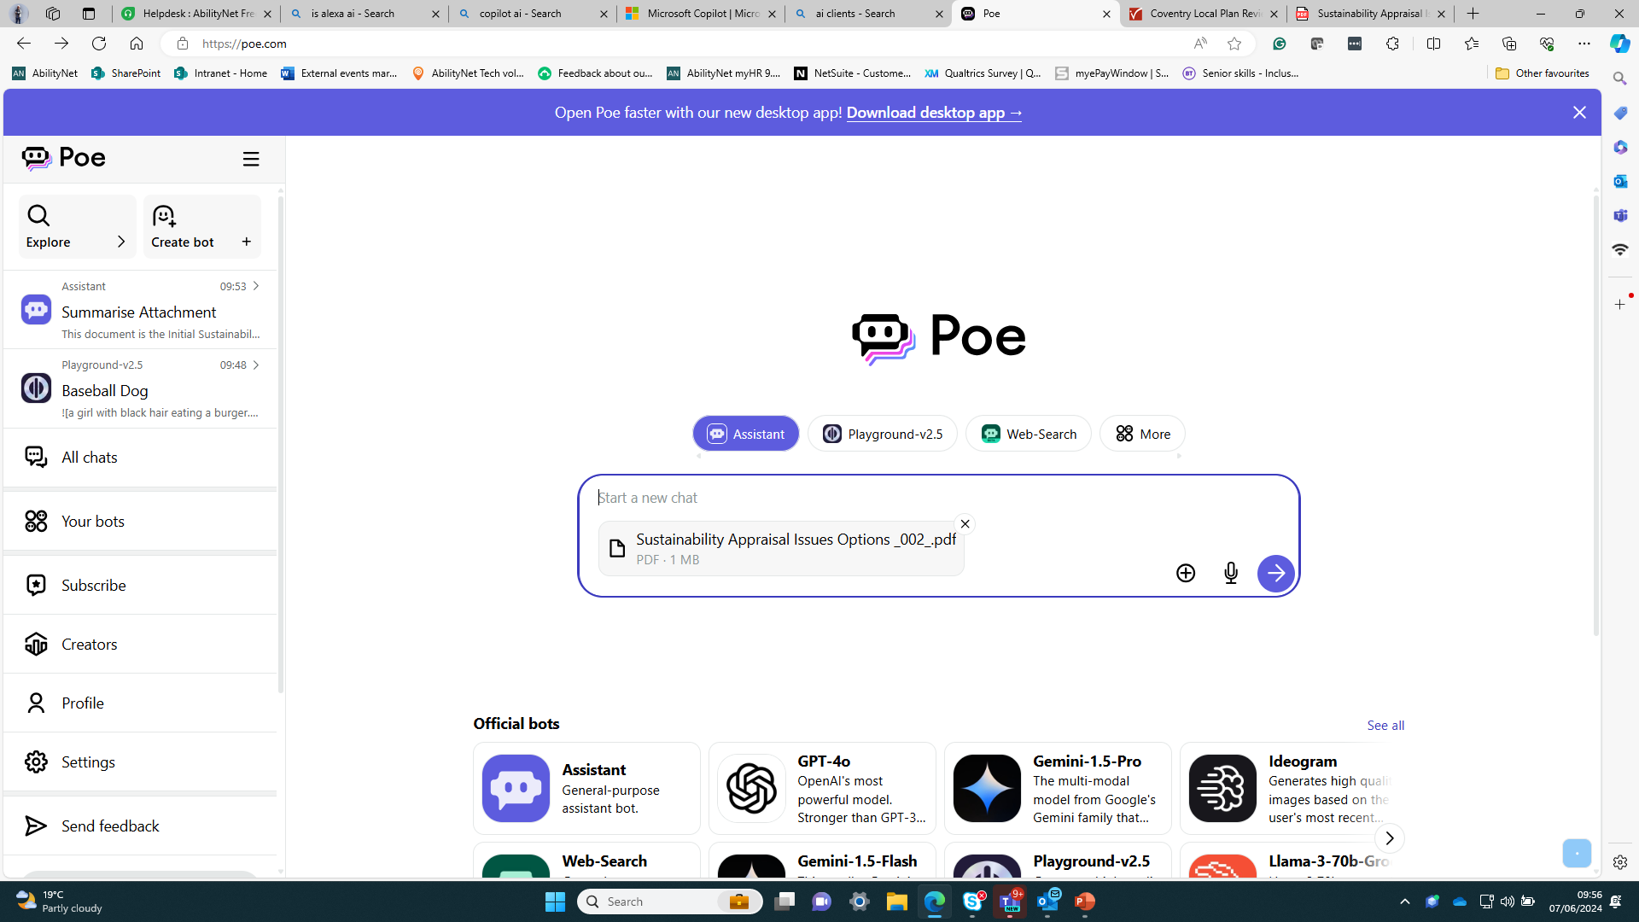
Can also summarise documents

Slide 12
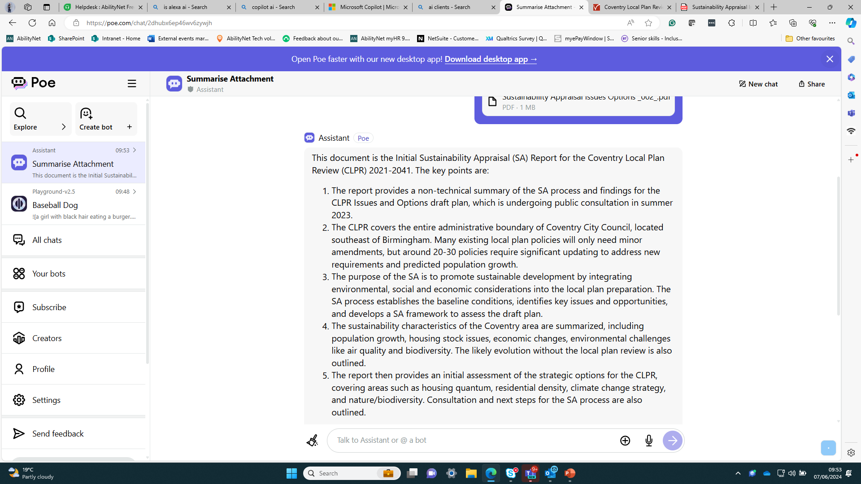

Slide 13
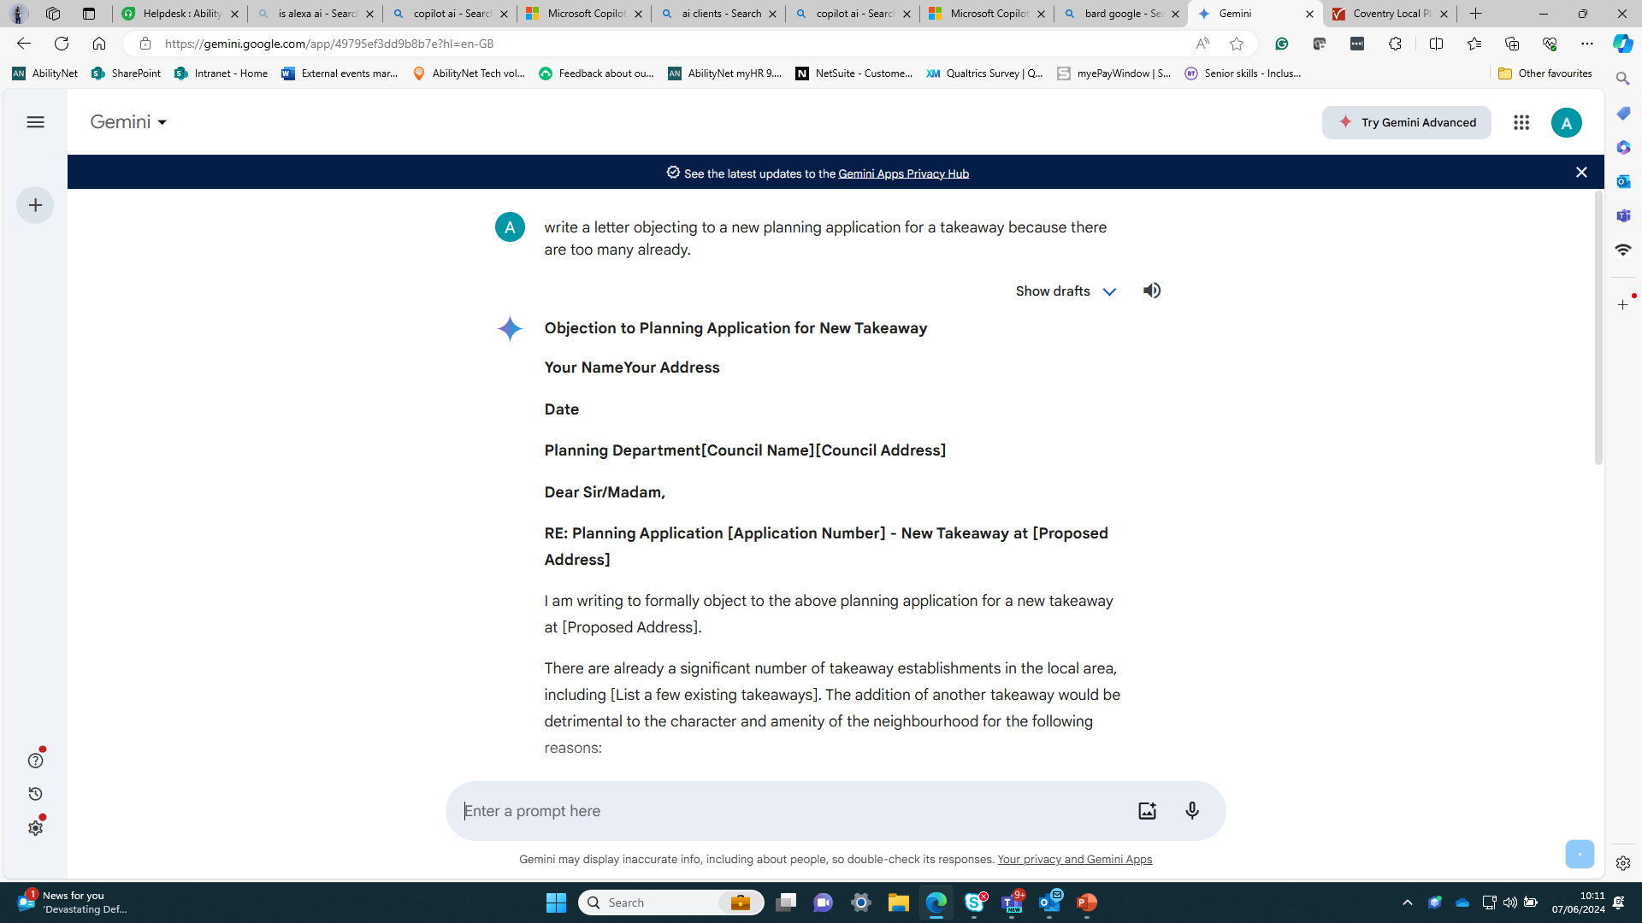
Can also help you write letters

Slide 14
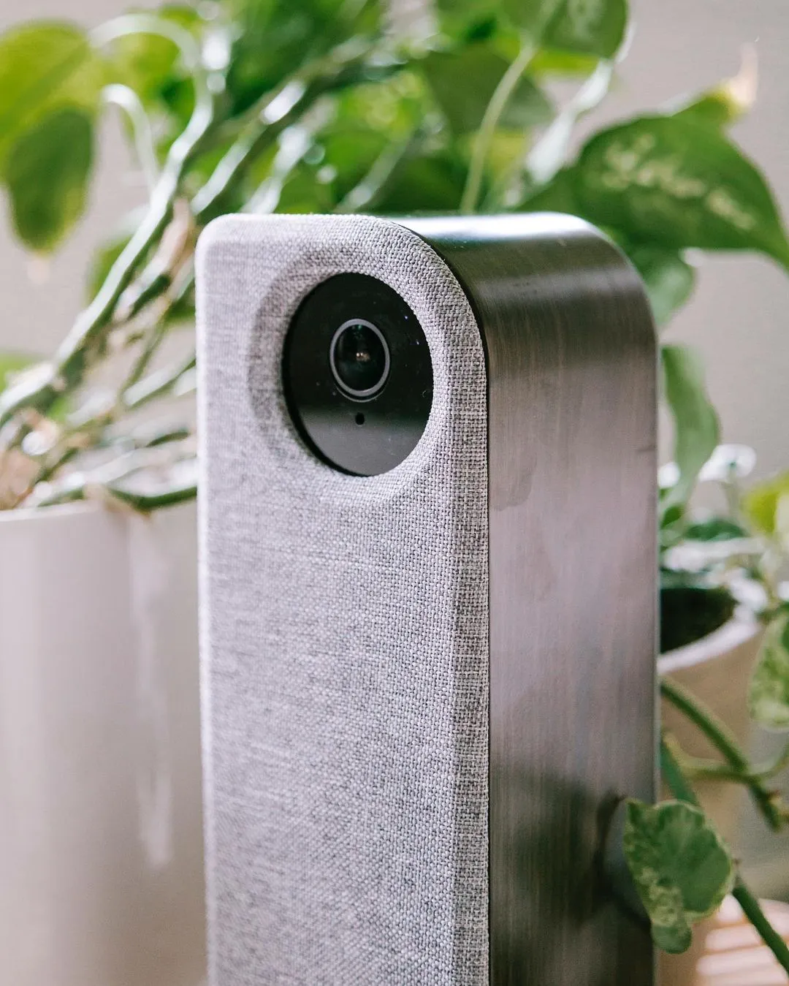
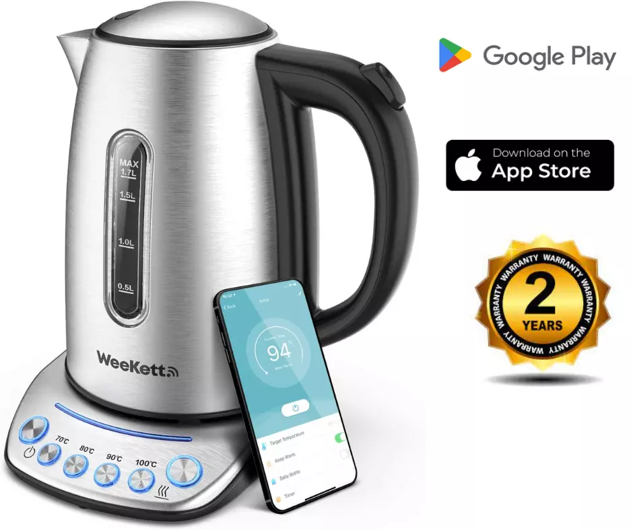
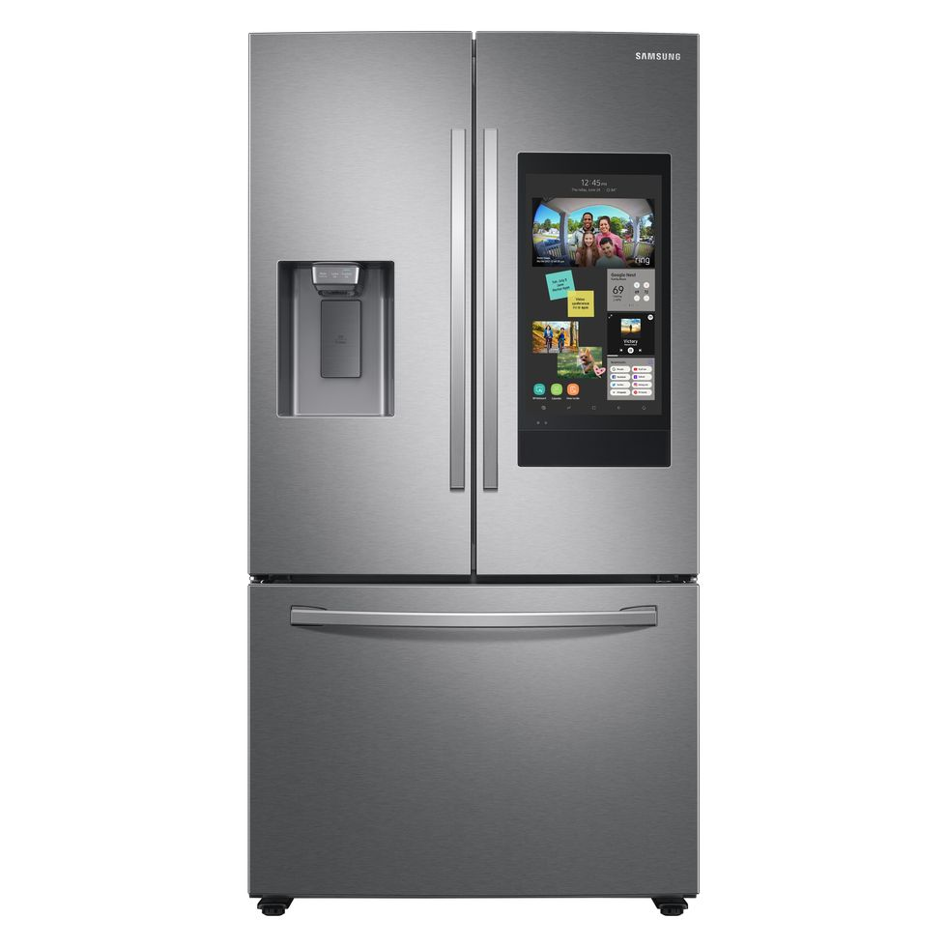
Smart home and AI
Notes:
Home Guardian
Smart fridge

Slide 15




Can help you to create graphics

Slide 16
Q&A

Slide 17
Contact us
Telephone:0300 180 0028
Email: alex.barker@abilitynet.org.uk

